Slide 1
Webserver Overview
A Webserver is a software which will manage WebPages and execute server side coding
“Web Server” is require when we want to host the application on a centralized location and wanted to access from many locations with diff users.
Web server is responsible for handle all the requests that are coming from clients, process them and provide the responses.

Slide 2
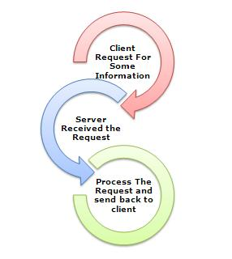
Webserver Overview

Slide 3
Webserver Overview
Webserver get the request from client and give the response to the client using diff protocols like http,ftp,https etc.
Diff Technologies used diff web servers.
Java
Jsp-tomcat,apache
Php
Tomcat, apache
.NET
Asp. Net- IIS(Internet Information service)

Slide 4
What is IIS
IIS (Internet Information Server) is one of the most powerful web servers from Microsoft that is used to host your ASP.NET Web application.
IIS has it's own ASP.NET Process Engine to handle the ASP.NET request. So, when a request comes from client to server, IIS takes that request and process it and send response back to clients.

Slide 5
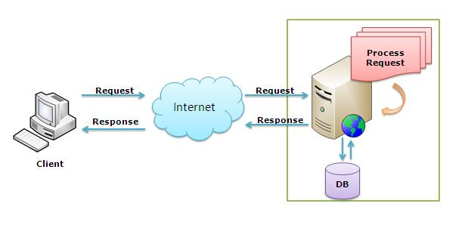
Webserver Overview

Slide 6
Webserver Overview
IIS comes inbuilt with operating systems.
IIS comes with Diff versions.
Windows XP IIS5.5
Windows Server 2000 IIS5.0
Windows Server 2003 IIS6.0
Windows Vista IIS7.0
Windows7 IIS7.5
Default physical path of webserver:
c:inetpub/wwwroot

Slide 7
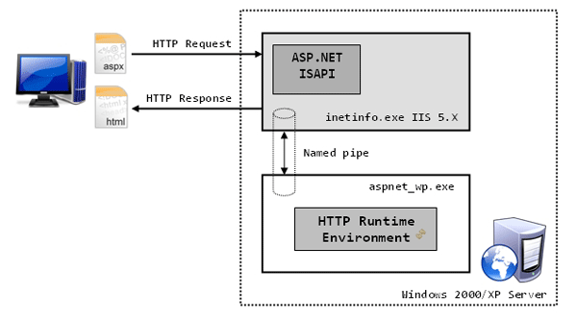
Internal Architecture of IIS 5.5 Model

Slide 8
Internal Architecture of IIS
We know when a request comes from Client (Browser) and sends to Server (we call it as Web server) in turn server process the request and sends response back to the client in according to the client request.
But internally in the web server there is quite interesting process that happens. To get aware of that process we should first of all know the architecture of the IIS
It mainly consists of 3 Parts/Files
1.Inetinfo.exe
2.ISAPI Filer (Container for Internet Server Application Interface dlls),
3.Worker Process (aspnet_wp.exe)

Slide 9
Internal Architecture of IIS
Inetinfo.exe:
Inetinfo.exe is the ASP.Net request handler
It handles the requests from the client .
If it's for static resources like HTML files or image files inetinfo.exe process the request and sent to client.
If the request is with extension aspx/asp, inetinfo.exe processes the request to ISAPI filter.

Slide 10
Internal Architecture of IIS
ISAPI filter :
Microsoft ISAPI technology as part of Internet Information Server (IIS). It Overcome the problems of earlier CGI(Common Gateway Interface) Technology.
ISAPI stands for Internet Server Application Programming Interface.
ISAPI filters process the asp.net page requests in web server.
ISAPI filter will have several runtime modules called as ISAPI extensions.
To process the request ISAPI filter takes the help of these runtime modules.
The runtime module loaded for ASP page is asp.dll.
The runtime module for ASP.NET page is ASPNET_ISAPI.dll.
From ISAPI filter request is processed to the "worker process".

Slide 11
Internal Architecture of IIS
Worker Process:
A Worker Process (aspnet_wp.exe) runs the ASP.Net application in the Web server IIS.
This process is responsible to manage all the request and response that are coming from client system.
All the ASP.Net functionality runs under the scope of worker process.
When a request comes to the server from a client worker process is responsible to generate the request and response. In a single word we can say worker process is the heart of ASP.NET Web Application which runs on IIS.
Asp.net runtime engine comes with a worker process called aspnet_wp.exe

Slide 12
Internal Architecture of IIS
Worker process sends the request to HTTPPIPE line.(HTTP Pipeline is nonetheless collection of .net framework classes). HTTP Pipeline compiles the request into a library and makes a call to HTTP runtime and runtime creates an instance of page class
public class File : System.Web.UI.Page {
}

Slide 13
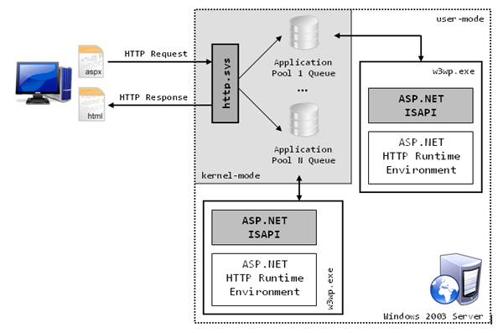
Internal Architecture of IIS 6 Model

Slide 14
Application Pool
Application Pool: Application pool is the container of worker process.
Application pools is used to separate sets of IIS worker processes that share the same configuration.
Application pools enables a better security, reliability, and availability for any web application.
The worker process serves as the process boundary that separates each application pool so that when one worker process or application is having an issue or recycles, other applications or worker processes are not affected.
This makes sure that a particular web application doesn't not impact other web application as they are configured into different application pools.

Slide 15
Webserver Overview
Virtual Directory:
Virtual directory is a alias for physical path
open files in physical path
http://localhost/filename [if the webserver in same system]
http://servername/filename [if the webserver in server system]
open files in virtual directory:
http://localhost/virtualdirectryname/filename [if the webserver in same system]
http://servername/virtualdirectryname/filename [if the webserver in server system]

